Slide 1

Air Piano!
0656044 邱虹瑜
0656047 平震傑

Slide 2

Demo video

Slide 3
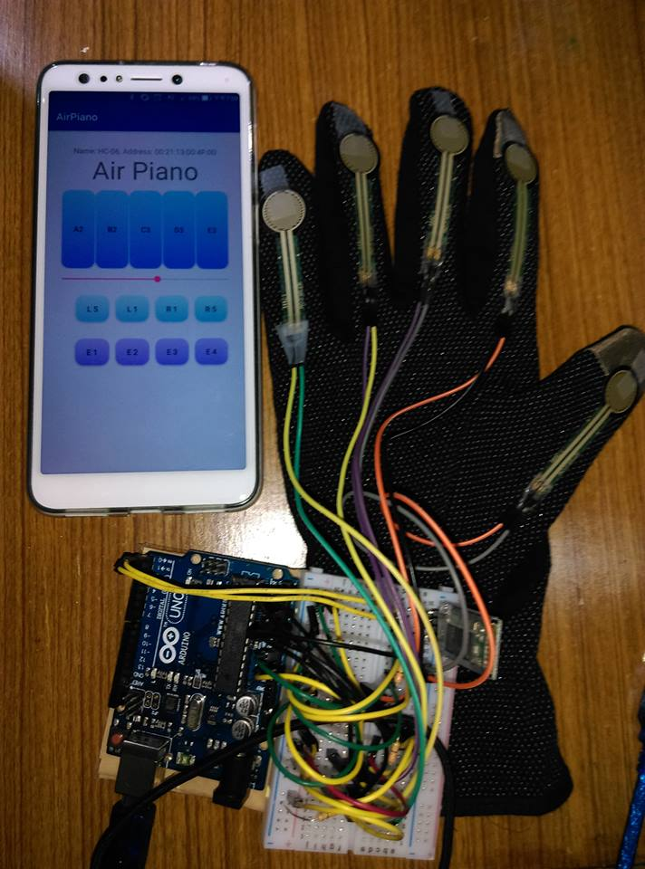
Introduction
Place 5 force sensor at fingertip, transmit the data to smartphone through blue tooth, and play piano sound corresponding to the data.
Volume of each note
Position of hand
Gesture of hand

Slide 4
Demo video (Volume)

Slide 5
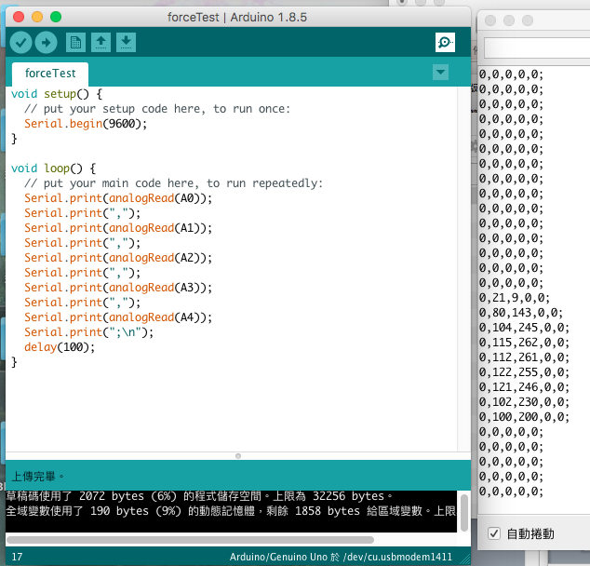
Volume of each note
The timing and volume of each note can be easily determined by the data of the force sensor. Whenever the value exceed a threshold, the app play the corresponding sound; In addition, larger value leads to a louder sound. The value is transmitted at a short interval so that the sound can be played at the correct timing.

Slide 6
Demo video (Position)

Slide 7
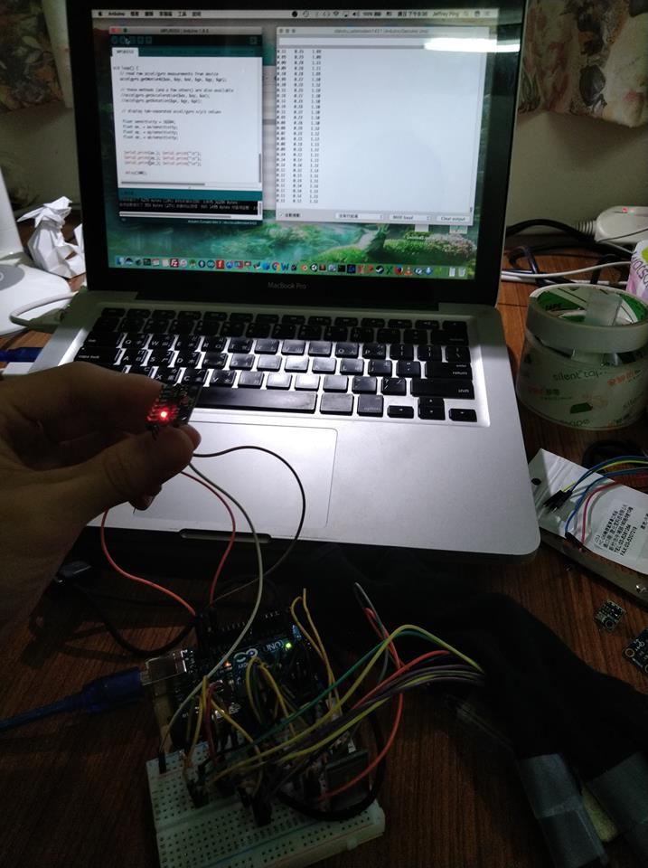
Position of hand
In the beginning we want to perform the movement of hand by the value of accelerometer, however the noise is too large to precisely find out the displacement. Thus, we add some buttons in the app to fulfill the function of the hand moving while playing.

Slide 8
Demo video (Gesture)

Slide 9
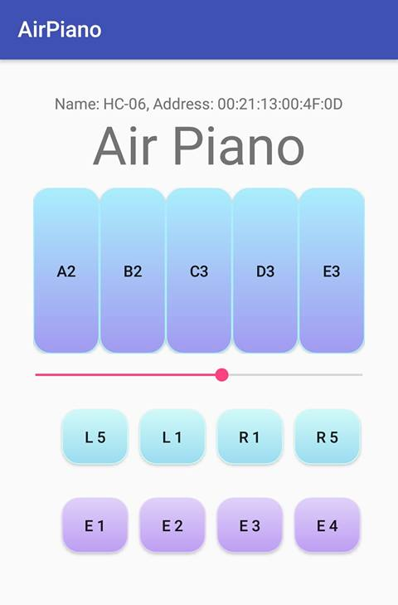
Gesture of hand
Extending the hand to reach a higher or lower note is a common situation while playing, but it’s hard to determine how wide the hand is opened, or even the position of each finger. Thus, we add another buttons to do this. If we figure out the solution in the future, these functions can be finished by simply replace the clicking listener by the value of sensors.

